Slide 1

LESSON 1
Introduction to GIS
History & Ecosystem • Getting Started • Applications • Why It Matters
JUMP TO A SECTION
01 Overview & Intro
02 Software Install
03 History & Ecosystem
04 GIS/GISc Applications
05 Why It Matters
Foundations of Geographic Information Science and Systems

Slide 2

Table of Contents
Five stops on today’s journey into GIS
Click any section below to jump straight to it →
01
Course Overview and Intro
02
Software Installation
03
History of GIS and ArcGIS Ecosystem
04
GIS/GISc Applications
05
Why GIS/GISc Matter
Introduction to GIS · 01 Course Overview & Intro
1

Slide 3



What Is GIS?
Geographic Information System(s) — the tools and technology behind this course
GIS = Geographic Information System(s) — software, hardware, data, and people working together to make sense of location.
The Technology
What It Does
The Industry
The software, hardware, and databases used to capture, store, and manage spatial data — like ArcGIS Pro, QGIS, and ArcGIS Online.
The core functions: capturing, storing, querying, analyzing, and visualizing anything that has a location — from a single address to a whole continent.
The products and markets built on top of GIS — location-based apps, imagery providers, and everyday tools people don't realize are GIS.
Introduction to GIS · 01 Course Overview & Intro
2

Slide 4



What Is GISc?
Geographic Information Science — the discipline that studies how GIS should work
GISc = Geographic Information Science — the theory and research behind every GIS tool and technique.
Spatial Data & Structures
Spatial Analysis & Statistics
How we model the real world as points, lines, polygons, and rasters — and the coordinate systems and topology that hold it all together.
The methods for finding patterns, relationships, and trends in geographic data — clustering, spatial autocorrelation, and geostatistics.
Spatial Cognition & Reasoning
Uncertainty, Ethics & Society
How people (and computers) perceive, represent, and reason about space — from mental maps to how a machine “understands” a boundary.
The limits of geographic data — error, bias, privacy, and the politics of who gets to make the map.
Introduction to GIS · 01 Course Overview & Intro
3

Slide 5



Course Description
What this course is about, in brief
Core Principles of GIS/GISc
Spatial data models, data collection, spatial querying, analysis and modeling, geodesy, map projections, cartography, and geovisualization.
Hands-On With Industry Software
Lecture builds the theory; labs put it into practice using ArcGIS Pro (and QGIS), the tools professionals use every day.
Spatial Thinking & Analysis
Lecture and lab work together to build the analytical skills needed to interpret and reason about geographic data.
A Project of Your Own
A semester-long GIS project lets you apply these skills with originality on a real topic that interests you.
Introduction to GIS · 01 Course Overview & Intro
4

Slide 6

Learning Objectives
By the end of this course, you will be able to:
Explain foundational GIS/GISc concepts, spatial thinking, and geospatial data models & structures.
Acquire, prepare, and manage spatial data — vector, raster, GPS, and tabular — from many sources.
Apply coordinate systems, map projections, and georeferencing correctly in real projects.
Operate GIS software (ArcGIS Pro & QGIS): editing, mapping, spatial queries, and joins.
Perform spatial analyses — buffering, overlay, proximity, raster/vector operations.
Compare the strengths, weaknesses, and assumptions built into different GIS functions.
Create effective, well-designed maps using core cartographic principles.
Design and execute an original GIS project addressing a real-world problem.
Introduction to GIS · 01 Course Overview & Intro
5

Slide 7
Course Roadmap
The four course modules, in order, and what each one covers
1
Introduction, Foundations, and Data Management
2
Tabular Data and Mapping
Course Overview and Intro; Software Installation
Attribute Table and Fields
History of GIS and ArcGIS Ecosystem
CSV Table Creation, Management, and Import
GIS/GISc Applications; Why GIS/GISc Matter
Field Creation, Editing, and Calculation
The Politics and Ethics of Mapping
Cartographic Principles
The Power of Maps & Map Types
Map Classification
ArcGIS User Interface
Map Elements, Layout, and Design
Data and File Types in the ArcGIS Ecosystem; File Management; Troubleshooting
Select by Attributes
Data Resources Exploration; Data Acquisition; Adding Data
Select by Location
Project, Map, Layer, and Geodatabase Creation
Table Join
Coordinate and Projection Systems
3
Spatial Analysis
4
Future of GISc
Spatial Join
Intro to Geospatial Programming
Buffer
Future of GISc
Clip
The capstone module — where the course brings everything together.
Dissolve
Overlay (Union/Intersect)
Raster Analysis: Surface Analysis
Map Algebra
Suitability Modeling
Introduction to GIS · 01 Course Overview & Intro
6

Slide 8
02
Software Installation
Getting ArcGIS Pro set up and ready to go
Sign in to your ArcGIS organization account
Find your license under My Settings
Download and install ArcGIS Pro

Slide 9
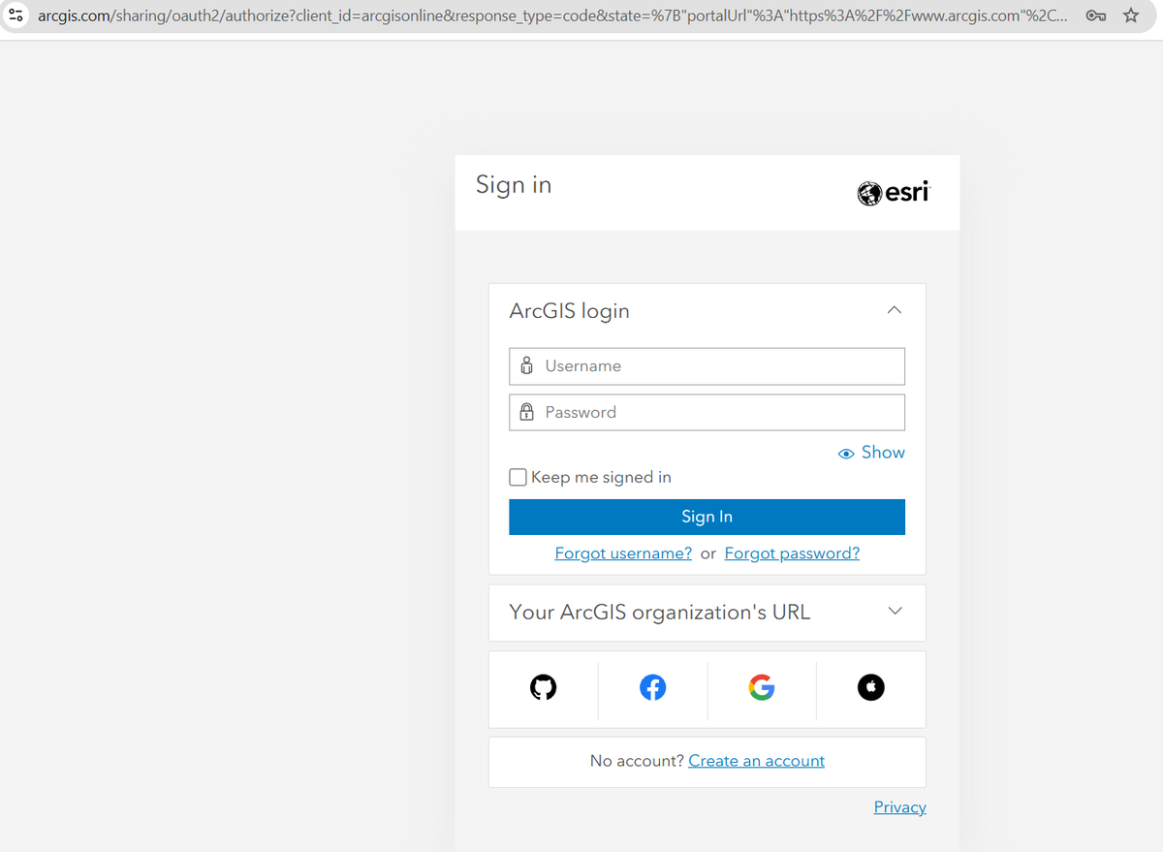
Installing ArcGIS Pro
Step 1 of 5 — Find the sign-in page
1
Go to arcgis.com
Search “ArcGIS Online” or visit arcgis.com directly, then click Sign In in the top right.
Introduction to GIS · 02 Software Installation
7

Slide 10

Installing ArcGIS Pro
Step 2 of 5 — Sign in
2
Enter your login credentials
Use the ArcGIS organization account you were invited to. Check your email for the invitation if you haven't set a password yet.
Introduction to GIS · 02 Software Installation
8

Slide 11
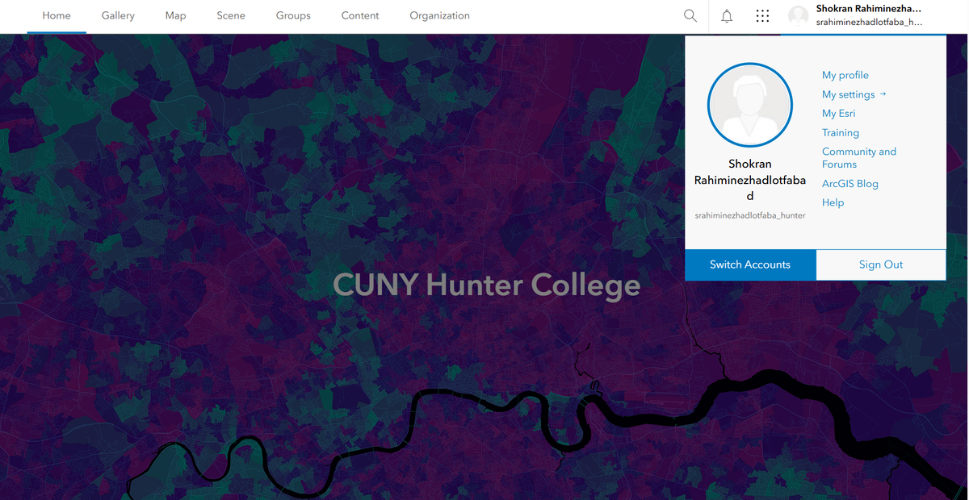
Installing ArcGIS Pro
Step 3 of 5 — Open your account settings
3
Click on My Settings
Open the profile menu in the top right corner and choose “My Settings” to see your available licenses.
Introduction to GIS · 02 Software Installation
9

Slide 12
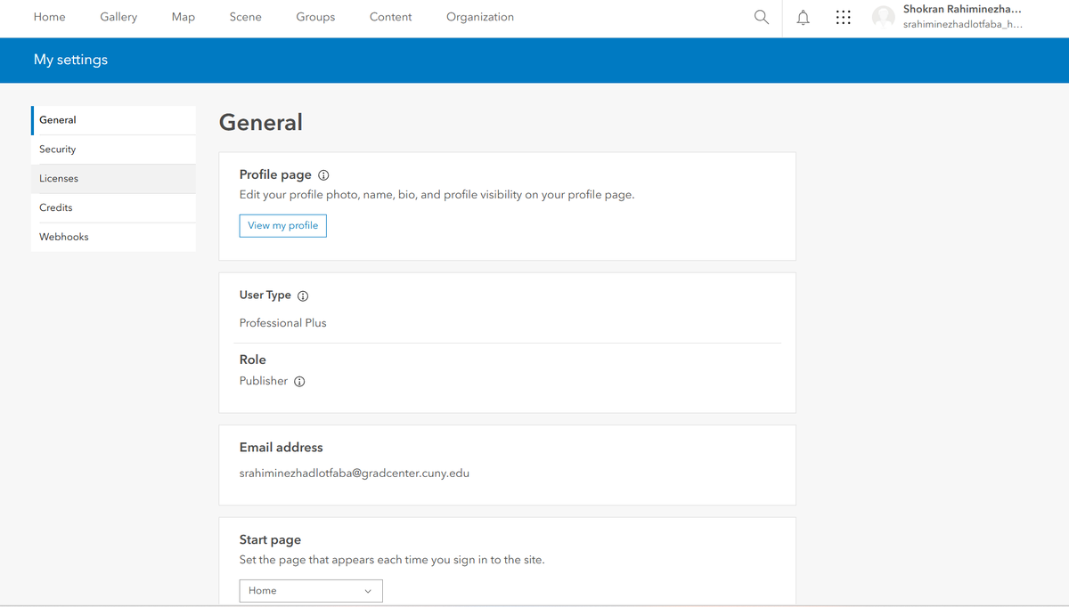

Installing ArcGIS Pro
Step 4 of 5 — Find your license
4
Click on Licenses
The Licenses tab lists every ArcGIS product your account can access, including ArcGIS Pro.
Introduction to GIS · 02 Software Installation
10

Slide 13
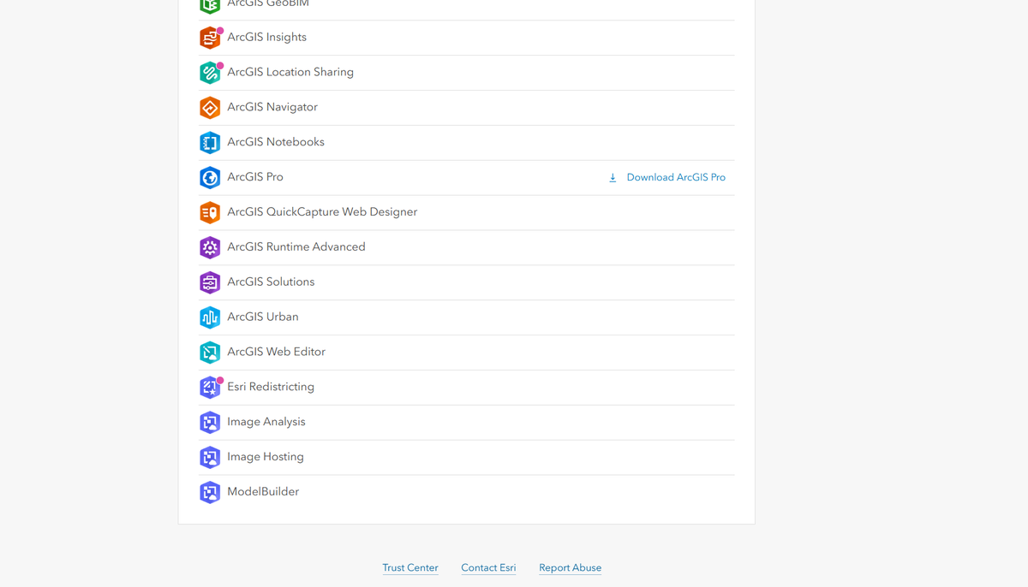

Installing ArcGIS Pro
Step 5 of 5 — Download & install
5
Scroll down and download
Find ArcGIS Pro in the list and click Download. Run the installer and sign in with the same account when prompted.
Introduction to GIS · 02 Software Installation
11

Slide 14
03
History of GIS and ArcGIS Ecosystem
From a 19th-century map to a modern software platform
How spatial analysis began — before computers existed
Esri's origins and the ArcGIS product family
Comparing platforms, file formats, and migration paths

Slide 15

GIS Didn’t Start With Computers
A historic example from 1854 London
Dr. John Snow’s 1854 Cholera Map
During a cholera outbreak in London, physician John Snow mapped every death by home address. The pattern revealed a cluster around a single water pump on Broad Street — pointing to contaminated water, not “bad air,” as the cause.
Water pump
It's considered one of the first uses of spatial analysis to solve a real-world problem — decades before “GIS” existed as a term.
Each dot = a cholera death, mapped by address
Introduction to GIS · 03 History of GIS & ArcGIS Ecosystem
12

Slide 16



Esri & the Origins of GIS Software
How a land-use consulting firm became the industry standard
FOUNDED
1969, by Jack and Laura Dangermond in Redlands, California.
ORIGIN
Started as a land-use consulting firm focused on environmental analysis and geographic research.
TODAY'S REACH
Used by roughly 350,000 organizations worldwide — governments, NGOs, universities, and private companies.
Introduction to GIS · 03 History of GIS & ArcGIS Ecosystem
13

Slide 17


The ArcGIS Ecosystem
Where the name “Arc” actually comes from
Esri built its first GIS software, Arc/INFO, in the late 1970s–early 1980s.
At the time, GIS data was stored using vector topology — maps built from points, lines, and polygons, where lines (arcs) connected the points (nodes) that formed the boundaries of shapes.
The name “Arc” was chosen because the software managed this arc-node topology — and it stuck through every product that followed: ArcInfo, ArcView, ArcMap, ArcGIS Online, and ArcGIS Pro.
Introduction to GIS · 03 History of GIS & ArcGIS Ecosystem
14

Slide 18




Comparing the Platforms
ArcMap, QGIS, ArcGIS Online, and ArcGIS Pro
1
2
3
4
ArcMap
QGIS
ArcGIS Online
ArcGIS Pro
Introduced with ArcGIS 8.0 (1999)
First released July 2002; 1.0 in 2009
Released 2012 for organizations
Version 1.0 released 2015
Desktop 10.x was the last major line
Free & open source
Browser-based, Software-as-a-Service
Windows-only, 64-bit
Being phased out in favor of Pro
Windows, macOS, Linux
No local install required
Esri's current flagship desktop app
Introduction to GIS · 03 History of GIS & ArcGIS Ecosystem
15

Slide 19

GIS File Formats: Storing Data
The everyday formats you'll open, save, and share
Format | Used In | Extension | Description
Shapefile | ArcGIS, QGIS | .shp (+.dbf, .shx) | The classic GIS format; stores vector features & attributes. Simple, but limited.
File Geodatabase | ArcGIS | .gdb folder | Esri's native format; stores multiple layers, tables, and relationships.
GeoPackage | QGIS, ArcGIS Pro | .gpkg | Open standard; a single file holding many layers (vector + raster).
Raster / Imagery | ArcGIS, QGIS | .tif, .img, .jpg, .png | Pixel-based data — elevation, land cover, satellite imagery.
Tables | All | .csv, .xlsx | Attribute data that can be joined to spatial layers.
Introduction to GIS · 03 History of GIS & ArcGIS Ecosystem
16

Slide 20
GIS File Formats: Projects & Styles
The files behind your workspace, symbology, and layouts
File | QGIS | ArcGIS Pro | Description
Project File | .qgz / .qgs | .aprx | Your workspace — stores map layouts, data links, and settings. Not the data itself.
Layer File | .qlr | .lyrx | Saves layer appearance (symbology, labels, scale visibility); points to your data.
Style File | .qml | .stylx | Color ramps, symbols, and fonts for consistent cartography.
Layout Template | .qpt | .pagx | Templates for printable maps: titles, legends, north arrows.
Package / Bundle | use .gpkg to share | .ppkx, .mapx, .tpkx | Ready-to-share versions of maps or projects with embedded data.
Introduction to GIS · 03 History of GIS & ArcGIS Ecosystem
17

Slide 21

Migrating ArcMap → ArcGIS Pro
A one-way street
ArcGIS Pro can import ArcMap projects
Import these
.mxd (map), .lyr (layer), .style (styles)
Pro converts to
.aprx, .lyrx, .stylx
Direction
One-way only — ArcMap cannot open .aprx files
Introduction to GIS · 03 History of GIS & ArcGIS Ecosystem
18

Slide 22
Moving Between QGIS & ArcGIS
What transfers cleanly, and what doesn't
Shared “safe” formats
Moving project-to-project
Shapefile (.shp)
QGIS → ArcMap
The data transfers well. The QGIS project, symbology, and layouts do not.
GeoPackage (.gpkg)
CSV (.csv)
ArcMap → QGIS
File Geodatabase (.gdb) — often read-only in QGIS
Move the data, not the project — QGIS cannot open .mxd files.
QGIS cannot open Esri project files (.mxd or .aprx) — but it can open the data those projects use.
Introduction to GIS · 03 History of GIS & ArcGIS Ecosystem
19

Slide 23
The Practical Migration Workflow
Three steps, whichever direction you're going
1
2
3
Identify what you're moving
Export to a neutral format
Rebuild the map design
Data (yes) vs. project layout/symbology (usually no).
Pro/ArcMap → .gpkg / .shp / .csv. QGIS → .gpkg / .shp / .csv.
Symbology and layouts usually don't transfer — recreate them in the new software.
Always check: coordinate system / projection · field names & data types · joins, relates, and null values
Introduction to GIS · 03 History of GIS & ArcGIS Ecosystem
20

Slide 24
04
GIS/GISc Applications
You already use GIS more often than you think
Who relies on GIS professionally
The location-based apps you use every day
Applications across industries and fields

Slide 25




Who Uses GIS?
Far more professions than most people expect
Engineers
City & Regional Planners
Environmental Agencies
Data Scientists & Analysts
Geologists
Archaeologists
Biologists
Real Estate Developers
...anyone who stores, analyzes, and depends on spatial data.
You've already used products built on GIS:
Starbucks
Zillow
Pokémon GO
DoorDash
site-selection modeling
property & neighborhood data
AR tied to real locations
delivery zone & routing
Introduction to GIS · 04 GIS/GISc Applications
21

Slide 26


GIS in Everyday Life
The “Services” pillar — a market most people never see
Beyond the software itself, GIS powers a huge market of location-based products and data services — most of which you interact with daily without ever thinking of it as “GIS.”
Navigation & Ride-Share
Weather & Environment
Location-Based Games
Turn-by-turn directions, ETA prediction, and route optimization.
Live radar, forecasts, and air-quality maps tied to your exact location.
Augmented-reality games overlaying gameplay onto real-world coordinates.
Delivery & Logistics
Local Search
Imagery & Data Providers
Matching orders to drivers and optimizing delivery zones in real time.
“Near me” search results, ranked by real distance and travel time.
Satellite and aerial imagery licensed to governments and businesses.
Introduction to GIS · 04 GIS/GISc Applications
22

Slide 27




Applications Across Fields
Almost every industry has a spatial layer to it
Urban Planning
Environment
Public Health
Zoning, transit routes, and infrastructure siting.
Habitat, land cover, and conservation tracking.
Disease spread, access to care, health equity.
Disaster Response
Government & Policy
Business & Logistics
Flood, wildfire, and evacuation modeling.
Redistricting, service delivery, census analysis.
Site selection, market analysis, delivery routing.
Introduction to GIS · 04 GIS/GISc Applications
23

Slide 28
05
Why GIS/GISc Matter
The mindset and the payoff — why this course is worth your time
Spatial thinking: the core skill behind every GIS task
How location leads to better decisions
Why data isn't useful until it has a “where”

Slide 29
Spatial Thinking: The Core Skill
Everything in this course builds toward asking better “where” questions
Spatial thinking is the habit of asking not just what is happening, but where — and why it's happening there.
Location
Where is it? How does that compare to everything nearby?
Pattern
Is there a cluster, a trend, or a relationship across space?
Process
What spatial relationship explains why it's happening there?
Introduction to GIS · 05 Why GIS/GISc Matter
24

Slide 30
Why Use GIS? Better Decisions
Seeing relationships, patterns, and trends in a geographic context
Where should we open a new store?
Which route gets a delivery there fastest?
Which neighborhoods will a hurricane hit hardest?
GIS turns questions like these into evidence-based answers — instead of guesses.
Introduction to GIS · 05 Why GIS/GISc Matter
25

Slide 31


It's Not Just Data — It's Location
The same numbers mean very little until you know where they happened
Non-Spatial Data
...Add a Location
Amount of electricity used
When it was last serviced
How many homes rely on this utility box
Now it's a point on a map, next to every other utility box in the city.
Patterns emerge: aging equipment clusters in one district, overloaded boxes line up along a single street, maintenance visits cluster near the depot.
On its own, this is just a spreadsheet row.
Introduction to GIS · 05 Why GIS/GISc Matter
26

Slide 32
Recap & Next Steps
You now know where GIS came from, how the ArcGIS ecosystem fits together, and how vector and raster data differ.
You installed ArcGIS Pro and signed in — you're ready to open the software next class.
You've seen who uses GIS, how it shows up in everyday apps, and why turning data into location leads to better decisions.
Next up: The Politics and Ethics of Mapping, and Map Types and Modern Maps — bring your laptop with ArcGIS Pro installed and signed in.
Questions before next class? Bring them — there are no bad questions in GIS 1.

